Slide 1

Discrete Distribution
Spring 2024

Slide 2
Bernoulli process
An experiment of repeated trials with two possible outcomes may be labeled success or failure.
We may choose to define either outcome as a success.
Each trial is called a Bernoulli trial.

Slide 3
Bernoulli Process
1. The experiment consists of repeated trials.
2. Each trial results in an outcome that may be classified as a success or a failure.
3. The probability of success, denoted by p, remains constant from trial to trial.
4. The repeated trials are independent.

Slide 4
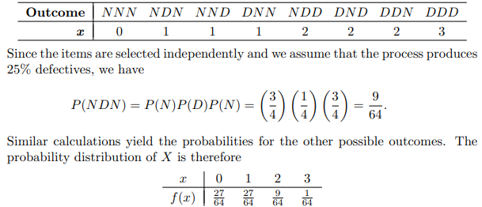
Example
Consider the set of Bernoulli trials where three items are selected at random from a manufacturing process, inspected, and classified as defective or nondefective. A defective item is designated a success. The number of successes is a random variable X assuming integral values from 0 through 3. The eight possible outcomes and the corresponding values of X are

Slide 5
Binomial Distribution
The number X of successes in n Bernoulli trials is called a binomial random variable.
The probability distribution of this discrete random variable is called the binomial distribution, and its values will be denoted by b(x; n, p).
First, consider the probability of x successes and n − x failures in a specified order.
Each success occurs with probability p and each failure with probability q = 1 − p

Slide 6
Theorem

Slide 7
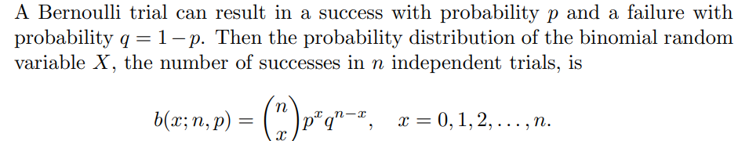
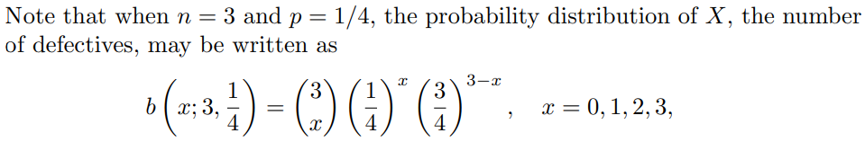
Binomial Distribution

Slide 8
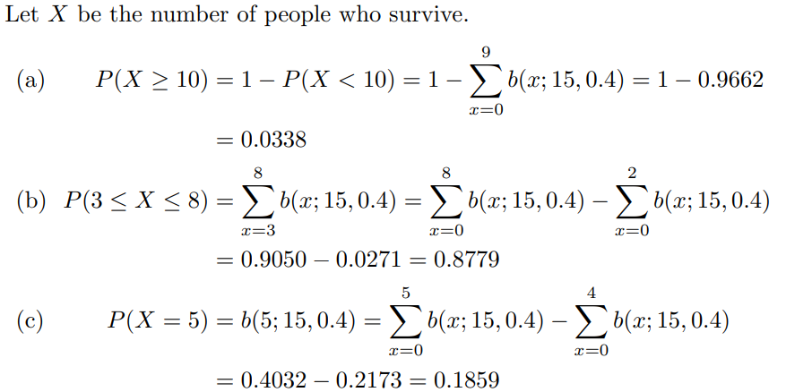
Example
The probability that a patient recovers from a rare blood disease is 0.4. If 15 people are known to have contracted this disease, what is the probability that (a) at least 10 survive, (b) from 3 to 8 survive, and (c) exactly 5 survive?

Slide 9
Hypergeometric Distribution
The hypergeometric are very similar to those for the binomial distribution.
The hypergeometric distribution does not require independence and is based on sampling done without replacement.
we are interested in the probability of selecting x successes from the k items labeled successes and n − x failures from the N − k items labeled failures when a random sample of size n is selected from N items.
This is known as a hypergeometric experiment

Slide 10
hypergeometric experiment
It possesses the following two properties:
1. A random sample of size n is selected without replacement from N items.
2. Of the N items, k may be classified as successes and N − k are classified as failures.
The number X of successes of a hypergeometric experiment is called a hypergeometric random variable. Accordingly, the probability distribution of the hypergeometric variable is called the hypergeometric distribution,

Slide 11
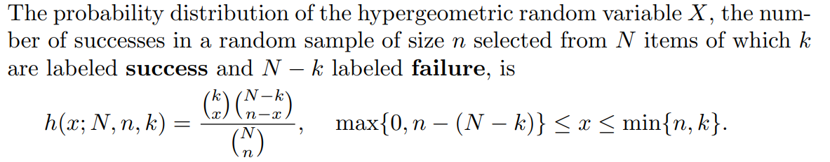
Hypergeometric Distribution

Slide 12
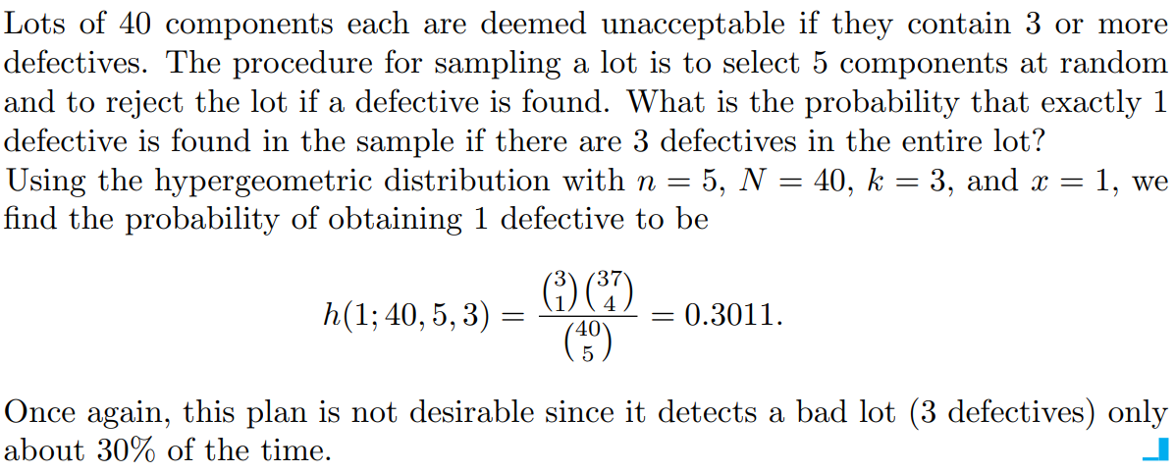
Example

Slide 13
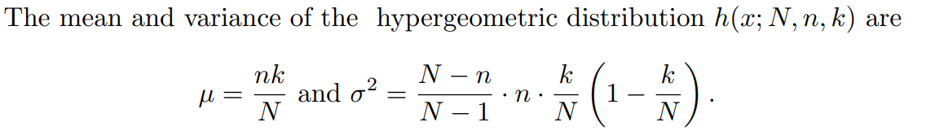
Theorem

